Slide 1
Audit Services
RFP Reference #2019-03

Slide 2

Questions:
Please hold all questions till the end of the presentation
Verbal responses provided by any of the Authority representatives during
our meeting today are not formal and are not binding on the Authority
All questions will be formally answered by May 3, 2019.

Slide 3
For All updates on this Bid, please go to:
www.flysyracuse.com
Click the SRAA tab
Click Bids/RFP/RFQ
    Scroll down to find the Audit RFP
Any changes, Q&A’s, Addendums, etc. will be located here

Slide 4
Key Dates in the RFP Schedule
Date | Event
May 21, 2019 | Issuance of Request for Proposals
Thursday, June 6, 2019 1:30 PM ET | Optional Pre-Proposal Conference, SRAA Board Room
Monday, June 10, 2019 2:30 PM ET | Closing Date for Respondent’s Questions
On or about Friday, June 14, 2019 | Final Response to Respondent’s Questions
Friday, June 21, 2019 2:30 PM ET | Proposal Submission Deadline
June 24 – July 5, 2019 | Proposal Evaluation Period and Respondent Interviews (if applicable)
No earlier than July 12, 2019 | Award of Contract by the Authority
July 31, 2019 | Execution/Entering into Contract

Slide 5
Bid Notes
One Original Bid – Marked Original
8 copies of the Bid – Marked Copy
One flash drive containing the complete Proposal
The Bid must be sealed and Marked with the Proposal Name and Reference Number:
Audit Services
RFP#2019-03

Slide 6
MWBE/SDVOB Goals
MWBE Goal = 30%
SDVOB Goal = 6%

Slide 7
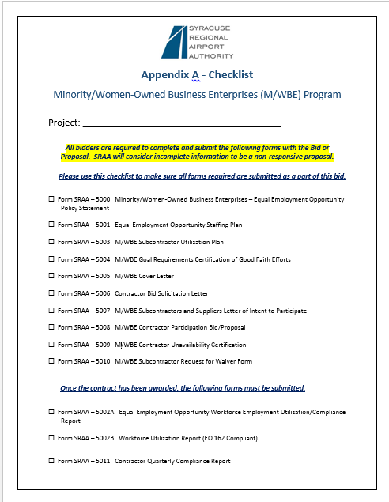
Appendix A Checklist
This is a checklist so you will not forget to
Include these important MWBE forms with your bid
For the first 10 forms, all bidders are required to complete and submit these forms
with the bid. SRAA will consider incomplete information to be a non-responsive
Proposal.

Slide 8
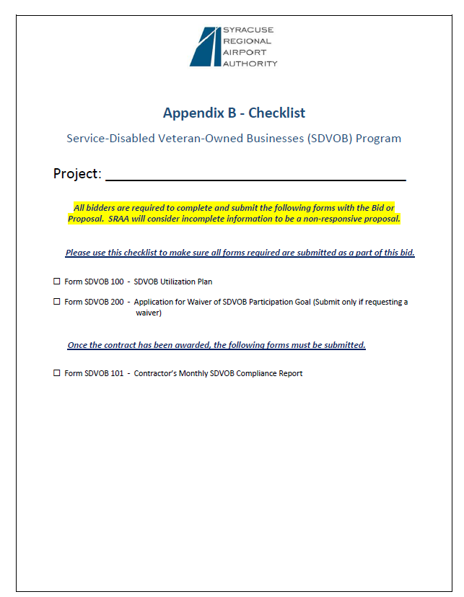
Appendix B Checklist
This is a checklist so you will not forget to Include these important SDVOB forms with your bid
All bidders are required to complete the 1st two forms on this checklist and submit them with the bid. SRAA will consider incomplete information to be a non-responsive Proposal.

Slide 9
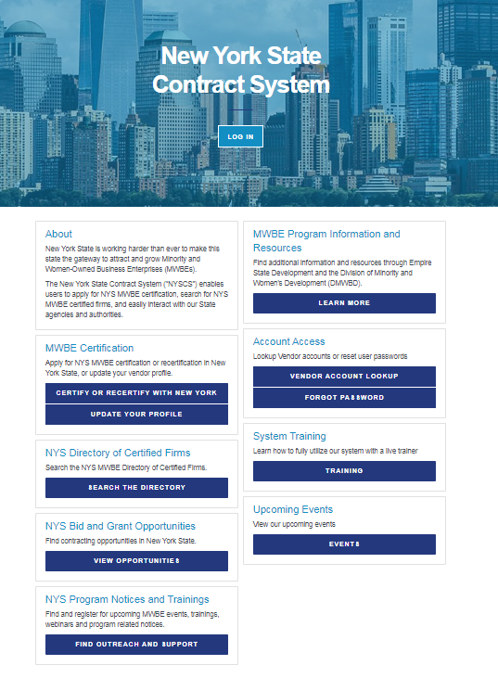
How to find MWBE’s
Go to the New York State Contract System:
https://ny.newnycontracts.com
In Business Description type “Audit Services”

Slide 10
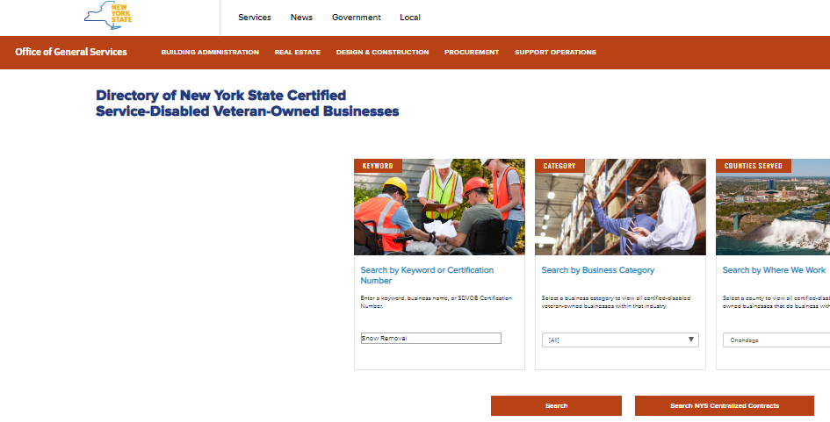
How to find SDVOB’s
Go to the Directory of NYS Certified Service Disabled Veteran
Owned Business
https://online.ogs.ny.gov/SDVOB/search
In Keyword Search type
“Audit Services”

Slide 11
Overview of Airport Audit Services
Basic Financial Statements
Required Reports by the Single Audit Act and Government Auditing Standards
Required Reports by the Passenger Facilities Guide for Public Agencies
NYS DOT Single Audit Report
Internal Controls over Compliance related to major programs
Report on Public Authorities Law
Report on Compliance for the PFC’s (Passenger Facility Charge) Program
Customer Facility Charge

Slide 12
Thank You!

